Slide 1


Slide 2
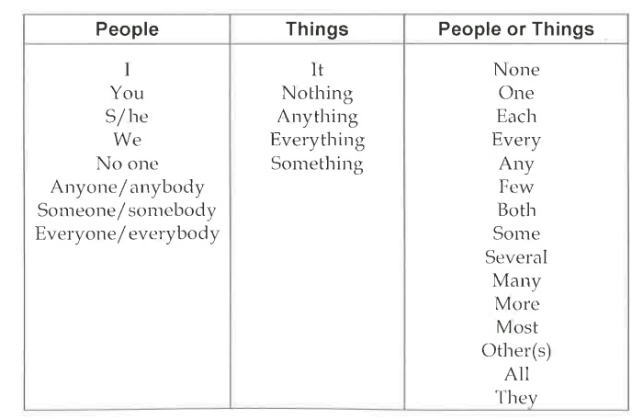

Slide 3
Most of them
All of them
Some of you

Slide 4



Slide 5



